Slide 1
The introduction to Biofuels
The enivermental science and engineering department of
Fudan university

Slide 2
basics
Biofuel generally refers to solid, liquid or gaseous fuels composed of or extracted from biomass, which can replace gasoline and diesel produced from petroleum. It is an important direction for the development and utilization of renewable energy.
The so-called biomass refers to all kinds of organisms produced by photosynthesis using the atmosphere, water, land, etc., that is, all living organic substances that can grow.
It includes plants, animals and microorganisms. Unlike traditional fuels such as oil, coal and nuclear energy, these emerging fuels are renewable fuels.

Slide 3
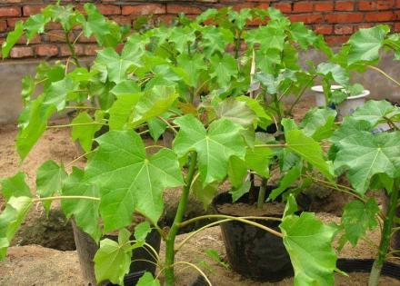
Current development
Since the 1970s, affected by the price of traditional energy, environmental protection and global climate change, countries around the world have increasingly attached importance to the development of biofuels.
At present, the united states and brazil are the world's first and second biofuel producers respectively.
The focus of research and development in china is mainly on the bio liquid fuel technology using cassava, sweet sorghum and other starch or sugar based non grain crops as well as lignocellulose as raw materials.

Slide 4
predictions
Since people began to use gasoline blended fuel in the 1970s, corn farmers have been urging people to use more ethanol as gasoline fuel. In addition to being used as livestock feed and export, the production of biofuels has now become the third largest use of corn.
The ethanol production industry uses corn as raw material, and the production scale is still expanding, which also means that the consumption of water resources is increasing.

Slide 5
challenges
In order to produce biofuels, many lands have been converted to agricultural land, especially the development of new agricultural land will destroy the ecology.
The massive use of biofuels has also caused food prices to rise and threatened the survival of the poor.
In order to manufacture and transport biomass fuel, it will produce pollution, carbon dioxide emissions and use water resources and fertilizers.
In some third world countries, farmers use the land originally used to produce food crops to grow energy crops, which is dangerous to reduce food production.

Slide 6
Thanks you!

